Slide 1
IDENTIFICATION OF ILLEGAL WILDLIFE TRADE ONLINE USING DEEP LEARNING
Under the guidance of
Mrs. N. Sravani
Assistant Professor, CSE
VNR VJIET, Hyderabad.
Presented by:
K Nikhil Kumar 16071A0585
Manik Soni 16071A0593
M A Soheb Moin 16071A0596
S Jeevan Rishi Kumar 16071A05B1

Slide 2
Agenda
Abstract
Introduction
Existing System
Literature Survey
Proposed System
Requirements (Software and Hardware)
Design
Implementation
Test Cases
Conclusion
Future scope
References

Slide 3
Abstract
Life on Earth is in the throes of a new wave of mass extinction, unlike anything since the demise of the dinosaurs.
In the last 500 years, 844 species – like the passenger pigeon, auk, thylacine, and quagga – are known to have died out, and up to 16,000 others are now known to be threatened. Two thirds of turtles could be gone by the 2025, great apes have recently declined by over 50% in parts of Africa, half of marsupials and one in three amphibians are in jeopardy, and a staggering 40% of Asia’s plants and animals could soon be lost.
Wildlife management systems have become increasingly popular in poaching prevention strategies. Sophisticated, efficient and cost-effective solutions exist yet there is still little evidence to show that poaching is not being effectively controlled.
In this project we will have a web scraping script that will fetch live data from various sources on the web involving animal content and this is then used to feed the deep learning model, which uses this data to predict the illegal sources of animal poaching.

Slide 4
introduction
The extinction of species has an increased rate which is 100 times above normal. Where 1/4th of bio-diversity is currently endangered including species of mammals and birds which is about 25% and 14%. Some scientists believe that the world is moving towards extinction and others believe it’s really happening.
Wildlife trafficking is one of the activities of extinction, namely agriculture activities, pollution and global climate change due to which various animals are becoming extinct.
According to " The Convention on International trade species of wild Plants and Animals (CITES) " is that it addresses the vital agreement with the wildlife trafficking and also divides the species that are being threatened based on the protection they have and also provided a framework that needs to be implemented by each party at national level.
Moreover, wildlife trafficking remains prominent and it is considered among all the illegal activities that are profitable behind drugs, human trafficking, counterfeiting and so on.

Slide 5
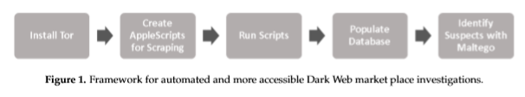
Existing system
The empirical efficacy of an analytical framework for scraping Dark Web marketplaces of interest, and correlating that data with Maltego and sites on the World Wide Web—a process that is outlined in Figure 1.
Unlike many traditional Websites, there is no worry about violating any terms of service when scraping Dark Web marketplaces, since they are unauthorized.
Furthermore, through research, determination of the Dark Web site that is scraped did not institute any type of throttling—a mechanism sometimes implemented on a Web server to prevent scraping or automated client requests.
Thus, there is no need to integrate any type of time delay into scripts. Since neither traditional Web browsers, nor the Tor browser, can robustly search for Dark Web marketplaces, they initially used specific Websites on the World Wide Web to locate Dark Web marketplaces of interest.

Slide 6
Literature survey
Sno | Title | Authors | Techniques | Drawbacks | Journal | Year
1 | Darknet Usage in the Illegal Wildlife Trade | Joss Wright | DarkNet – AlphaBay, Web crawling usage | Doesn’t have a proper monitoring on Darknet | Soc ArXiv | 2019
2 | In Search Of Cyber-Enabled Disruption | Simone Haysom | Insights from Digital Dangers in Internet | Only dangers of Darknet are discussed | Global Inintiative | 2019
3 | Wildlife traffic over the internet: a market compared to virtual drug trafficking? | Elodie Demeau, Miguel Eduardo Vargas-Monroy, Karolan Jeffrey | Comparison of Wildlife illegal Trade and Green criminology on Wildlife | Only 25% of the Darknet Markets are being seen | Sci-Elo | 2019
4 | A framework for investigating illegal wildlife trade on social media with Machine learning | Enrico Di Minin, Christoph Fink , Tuomo Hiippala and Henrikki Tenkanen | Investigating Wildlife trade using ML Algorithms on Social Media | Large Datasets and various API’s are to be utilised | Conservation Biology | 2019
5 | Use of Machine Learning to Detect Wildlife Product Promotion and Sales on Twitter | Qing Xu, Jiawei Li Mingxiang Cai and Tim K. Mackey | (1) Manual search; (2) Data collection; (3) Data processing; and (4) Data analysis. | Limited to English language tweets and the no of known code words for illegal wildlife products are limited. | Frontiers in Big Data | 2019

Slide 7
Sno | Title | Authors | Techniques | Drawbacks | Journal | Year
6 | Stay Ahead of Poachers: Illegal Wildlife Poaching Prediction and Patrol Planning Under Uncertainty with Field Test Evaluations | Lily Xu , Shahrzad Gholami Sara Mc Carthy , Bistra Dilkina , Andrew Plumptre, Milind Tambe, Rohit Singh, Mustapha Nsubuga, Joshua Mabonga, | PAWS (Pets are Wonderful Support) using Game Theory and Machine Learning, GSG’s (Green Security Games) | GPS Trackers and Landscape of wild life area can be deflected in a terrain conditions | arXiv | 2019
7 | The role of the anthropogenic Allee effect in the exotic pet trade on Facebook in Thailand | Penthai Siriwata, K.A.I. Nekarisb ,Vincent Nijmana | Generalised linear models to explain price dynamics | Photo limitations in Facebook and requires high samples of data | ELSEVIER | 2019
8 | Illegal wildlife trade – surveying open animal markets and online platforms to understand the poaching of wild cats | Vincent Nijman, Thais Morcatty, Jaima H. Smith, Sadek Atoussi, Chris R. Shepherd | Monitoring of Wildlife Trade across the world | Limited to Survey | Taylor & Francis | 2019
9 | A Framework for More Effective Dark Web Marketplace Investigations | Darren R. Hayes, Francesco Cappa and and James Cardon | Framework is developed in order to investigate on Darknet Markets | Forensic Software is utilised and takes time to pinpoint markets | MDPI | 2018
10 | Assessing consumer trends and illegal activity by monitoring the online wildlife trade | Yik-Hei Sunga, Jonathan J. Fongc | Comparison of import data and CITE based database models are developed | Large surveys and Demand for Morphology is required | ELSEVIER | 2018

Slide 8
Sno | Title | Authors | Techniques | Drawbacks | Journal | Year
11 | Survey: Wildlife Trade and Related Criminal Activities Over the Internet | Abdul Razaque, Du Kejun, Zhu Xueqi, Li Wanyue | Survey on illegal wildlife trade on Internet | Only given Insights | IEEE | 2018
12 | Exploring the international trade in African snakes not listed on CITES: highlighting the role of the internet and social media | Timm Juul Jensen, Mark Auliya, Neil David Burgess, Patrick Welby Aust, Cino Pertoldi, Julie Strand | Identification of Reptile species using CITE appendices online | Reptile species data is humongous and results are to be found | Springer | 2018
13 | Criminal motivation on the dark web: A categorisation model for law enforcement | Janis Dalins, Campbell Wilson, Mark Carman | Categorization model on TOR URL’s | No Setbacks mentioned | Elsevier | 2018
14 | Code word usage in the online ivory trade across four European Union member states | Sara Alfino and David L. Roberts | Identification of trade using ‘key word’ | Consistency of data to be considered | Cambridge | 2018
15 | Illegal pet trade on social media as an emerging impediment to the conservation of Asian otters species | Penthai Siriwat, Vincent Nijman | Pet trade on social website by classification | Enforcements methods to be discussed | JAPB | 2018

Slide 9
Proposed System Architecture
Trained on Amazon
Sagemaker
Wildlife data from Kaggle
DenseNet121
Data Preprocessing
14 classes
Data from
Illegal websites
Pre-trained on
Image-net

Slide 10
proposed system Components
Amazon Sagemaker Jupyter Notebook Instance:
RAM 192GB
CPU Cores 64
Disk Space 256GB
GPU None
Kernel PyTorch
URL: https://test-sonmanik-ml.notebook.us-east-1.sagemaker.aws/lab

Slide 11

Proposed System: Data
1.1 Web Scraping:
We use the web scraping script to download images from a website in bulk
As not all images in the website are wrapped inside the <img> tag we had to additional filter functions to make sure all the images are fetched from a website
If images were being loaded from a link then the script will directly them via the link
Multi threading was used to make the process of fetching images efficient

Slide 12
Proposed System: Data
1.2 Data from Kaggle
We scraped the data from web. In addition to that, to increase the training data,
we used data from Kaggle, which consist of 14 different types of animals’ images.
The data will help the model to classify the input more accurately.
https://github.com/visipedia/iwildcam_comp

Slide 13
Proposed System: Deep Learning Model
Output
Testing Data
23 gigabytes, 170K+ images
Training Data
18 gigabytes, 120K+ images
Dense Net
Densenet121
ImageNet
Pre-trained on imageNet

Slide 14
DenseNet121 Architecture:

Slide 15
Compute Requirements
64 GB RAM
Internet Connectivity
Linux OS
Python 3.x
NVIDIA K80 GPU 8 GB
CPU i7 8th gen

Slide 16
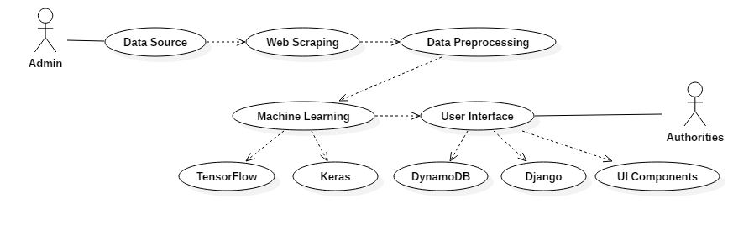
Use Case diagram

Slide 17
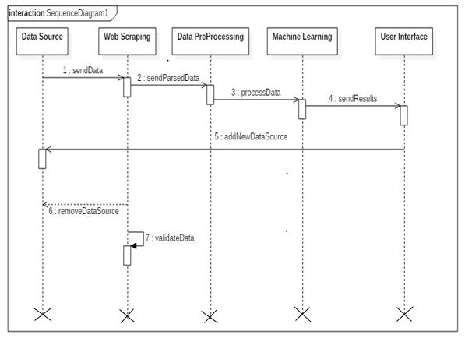
Sequence diagram

Slide 18
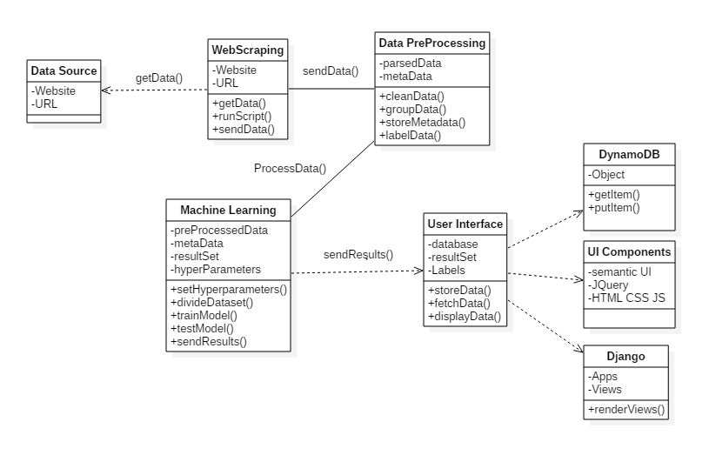
class diagram

Slide 19
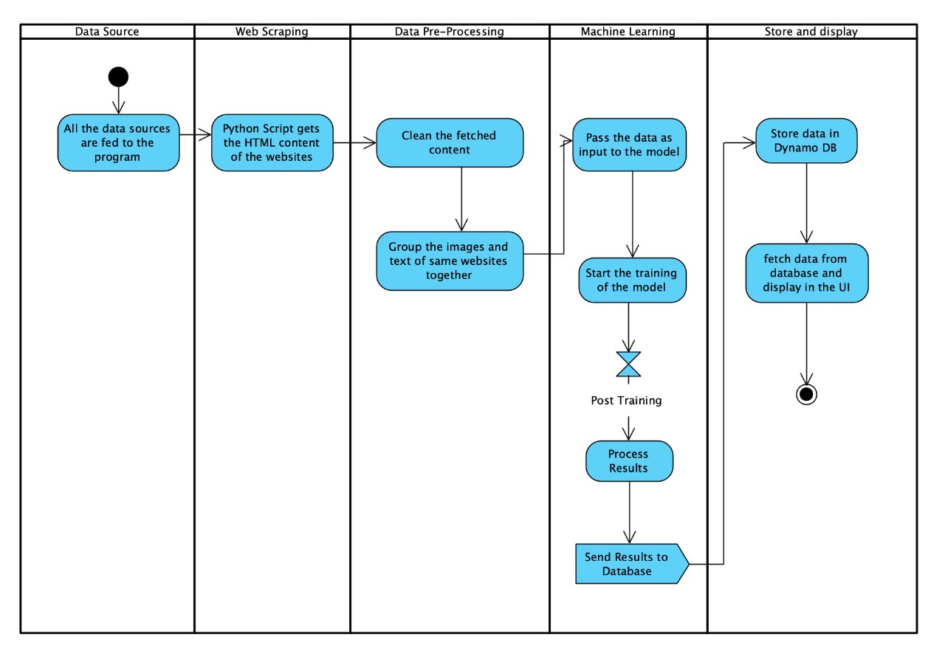
Activity diagram

Slide 20
Implementation
We download images from a website by saving them through a browser. But those images were always in image format. What we did is scrape a bulk amount of images by writing a few lines of code in python.
The task could be more extensively done by spawning multiple threads to pertain more images/second, meaning more speed or connections per second. We will be using libraries like requests, urllib2 and mechanize to get source information from a web source and can then save it through ‘shutil’ library to get the final copy on our drive.
Requests is a high-level networking library for opening web connections while we would use it to get the binary form (data) of image. And this is going to be our first step. The requests library is usually to do us the favour of getting the web page source code.

Slide 21
Implementation
Test Model
https://www.kaggle.com/maniksoni/wildlife-trade-manik-soni/edit
Original Model:
https://test-sonmanik-ml.notebook.us-east-1.sagemaker.aws/lab
Model: DenseNet121.
Pre-trained yes
Pre-trained model ImageNet
Learning rate: 0.005
Momentum: 0.1
Optimizer: Adam
Due to very large number of images, We created a test model which contains 32x32x3 sized images.

Slide 22
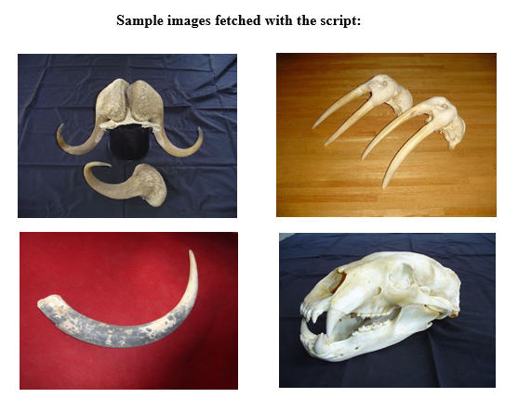
Sample Images fetched with python script.

Slide 23
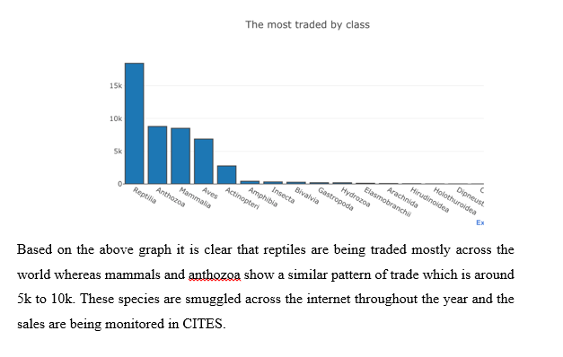
Analysis

Slide 24
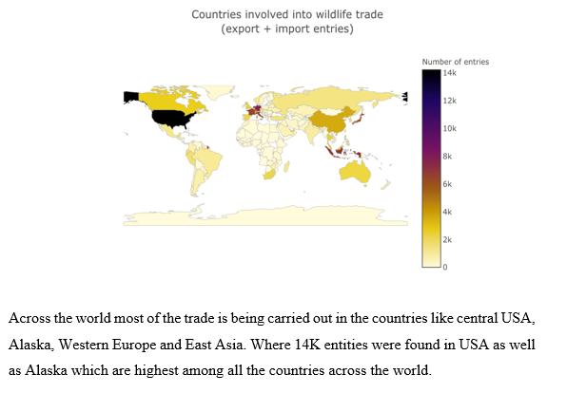
Analysis

Slide 25
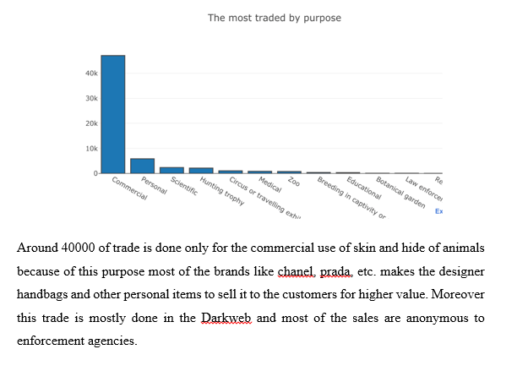
Analysis

Slide 26
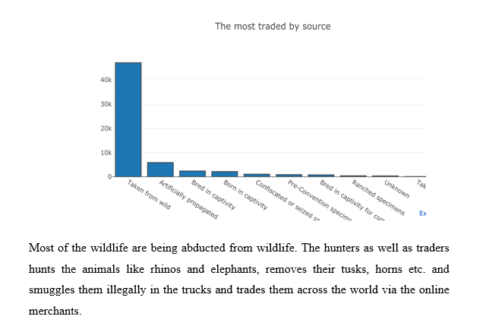
Analysis

Slide 27
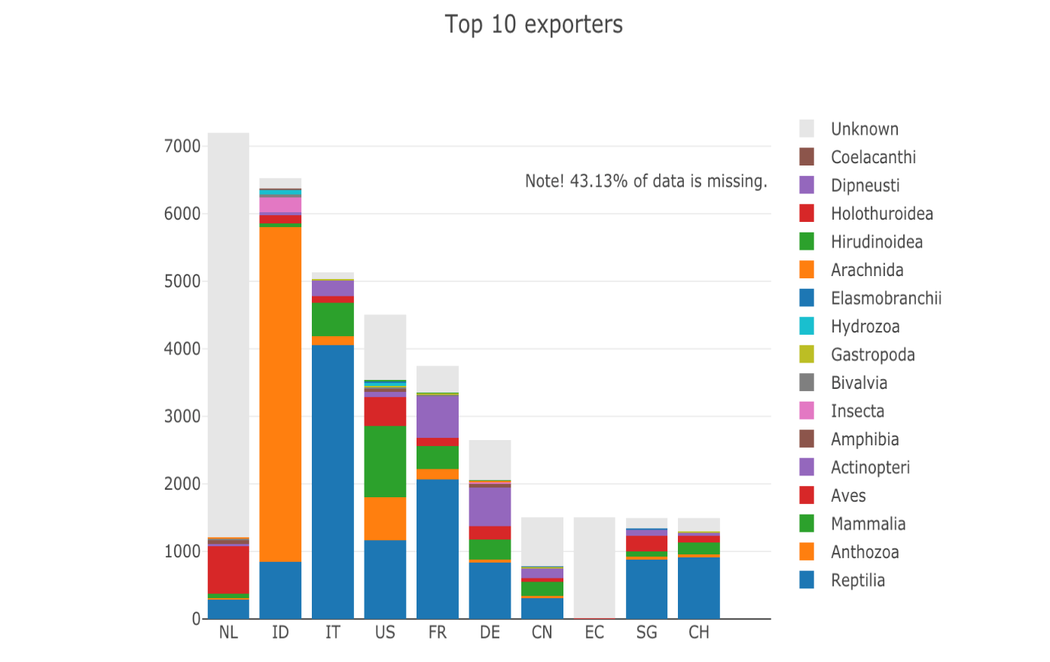
Analysis

Slide 28
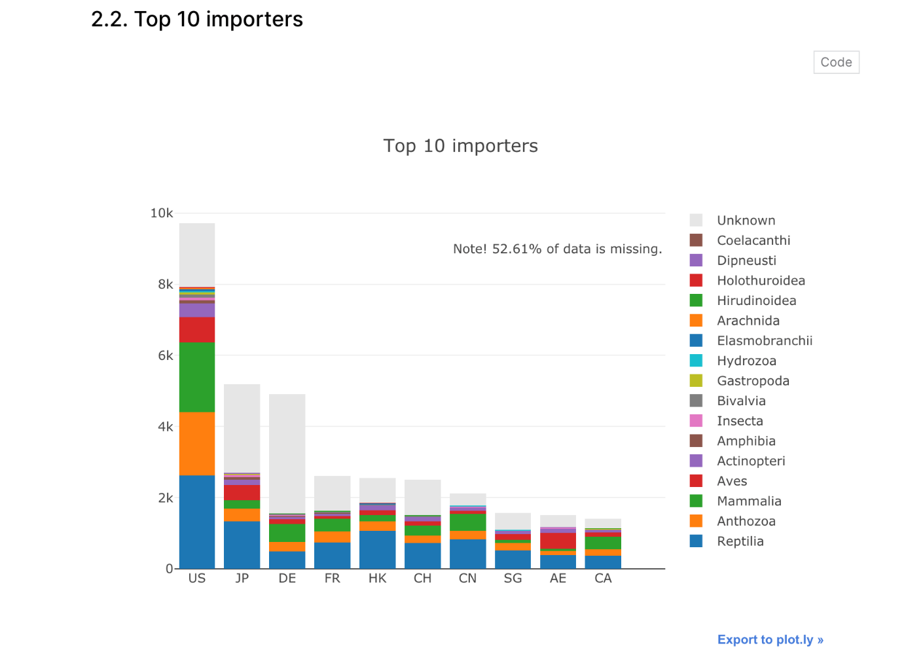
Analysis

Slide 29
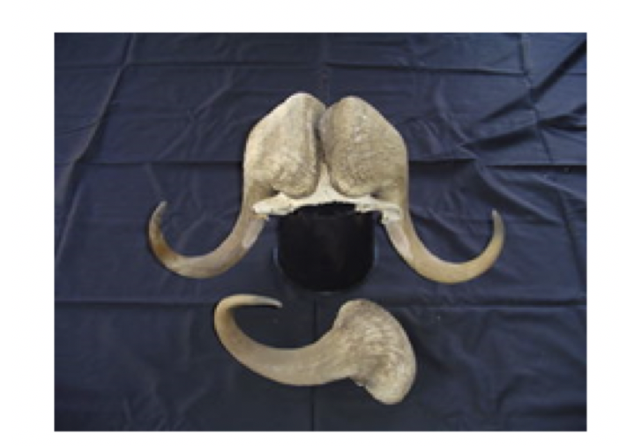
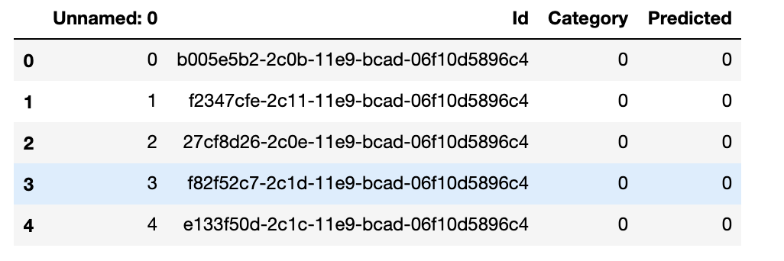
Test cases
Output from the Test model
https://www.kaggle.com/maniksoni/wildlife-trade-manik-soni/edit
Sample input: b0053e6nj-11e9-bcad-06f5896c4
Correct: Illegal(1), Predicted 1(Illegal)

Slide 30
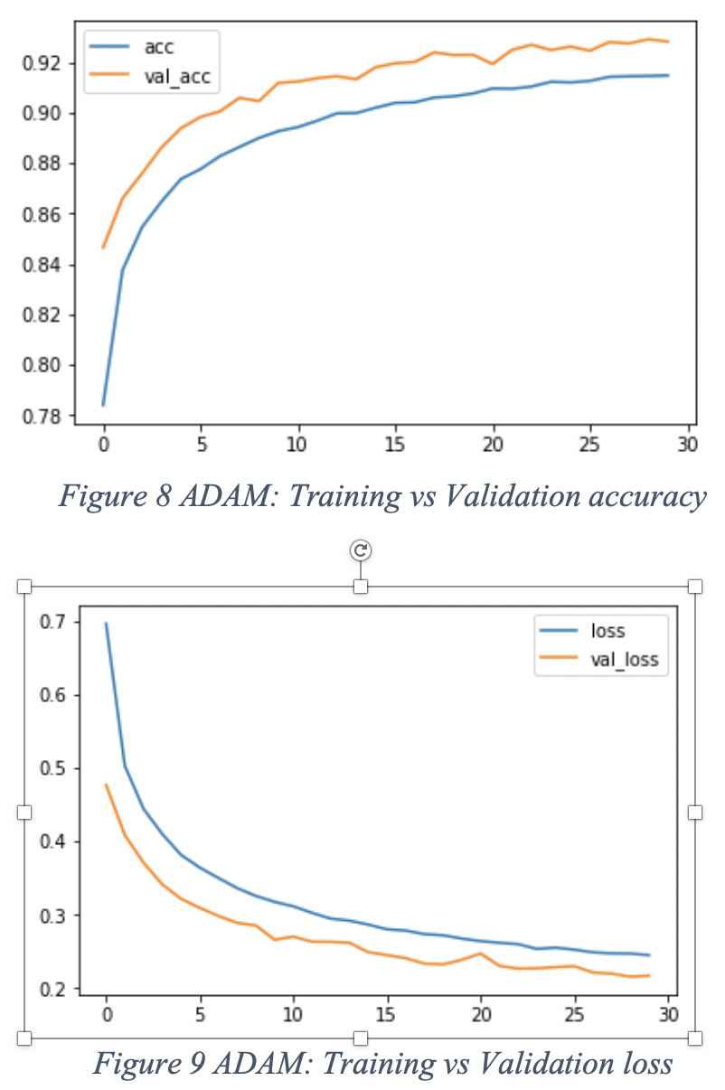
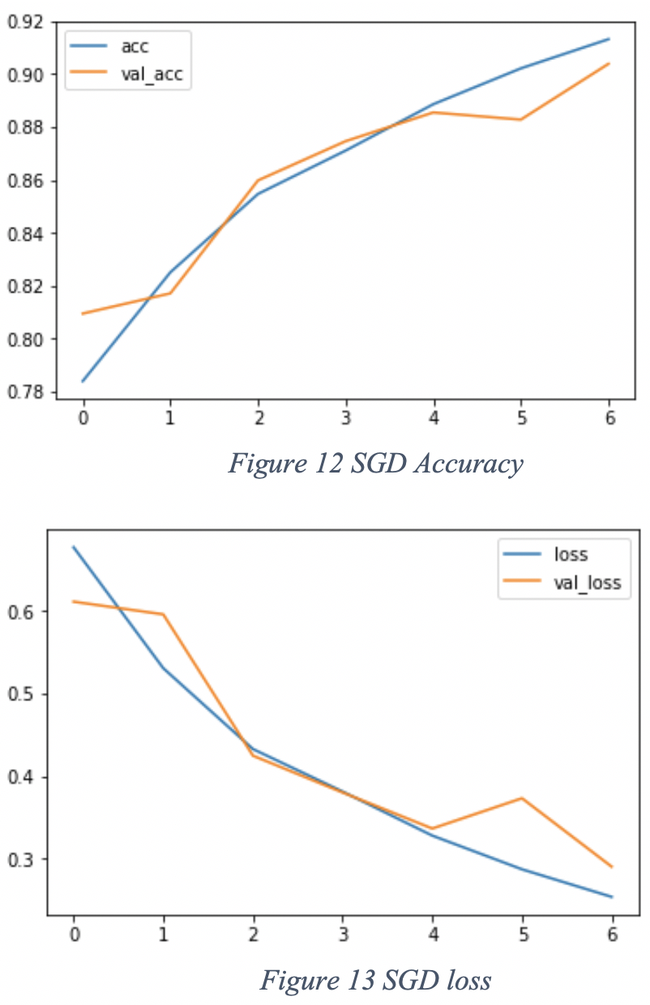
Training Result
Accuracy: 92.3%
Precision: 0.85
Recall: 0.83
ADAM
SGD

Slide 31
Conclusion
Data related to Internet commerce is purely restricted and depends mainly on IFAW and TRAFFIC, these are the two NGO's who are trying to monitor the illegal wildlife trade and also improved their methods in identifying this illicit trade.
Most of the researchers has tried to identify the type of species which are being trafficked and moreover they tried to identify the geospatial location of the trade which was being carried out by the dark market sellers.
The results which came out of these experiments were satisfactory but some of the results has shown some false positives like for example the word "ivory" is a color as well as item so there is ambiguity in identifying these key words.
Finally, the online illegal wildlife trafficking is a crucial and important issue which needs to be considered and there are various challenges associated with it. Moreover the current laws do not provide any protection to the wildlife species. New methods and frameworks are to be developed by researchers and enforcement agencies to stop this illegal trade.

Slide 32
Future scope
The Darknet is characterised by substantial turnover of marketplaces, many of which last less than a year before being shut down. A key recommendation is to maintain the ongoing capacity to track emerging markets, the geographic locations that they serve, and the range of products on offer.
Whilst many such marketplaces use off-the-shelf auction software, each requires manual effort to automate 'scraping' tools that monitor transactions, requiring ongoing effort.
The Darknet has significant potential for the illegal wildlife trade, despite the current low volumes shown in recent studies.
With increasing adoption of technologies such as cryptocurrencies, however, and growing international enforcement efforts to prevent the trade in illegal wildlife products, the Darknet is a proven venue for both high- and low-value illicit products.

Slide 33
references
[1] Ceballos, G., Ehrlich, P.R., Barnosky, A.D., García, A., Pringle, R.M. and Palmer, T.M. (2015). Accelerated modern human-induced species losses: Entering the sixth mass extinction. Science Advances, 1(5), 1-5.
[2] Maxwell, S.L., Fuller, R.A., Brooks, T.M. & Watson, J.E.M. (2016). Biodiversity: The ravage of guns, nets and bulldozers. Nature, 536(6515), 143-145. https://doi.org/10.1038/536143a
[3] Van Uhm, D.P. (2018). The social construction of the value of wildlife: A green cultural criminological perspective. Theoritical criminology, 22(3), 384-401.
[4] Sollund, R. (2016). Wildlife Trafficking in a Globalized World: An Example of Motivations and Modus Operandi from a Norwegian Case Study. In F. M. Angelici (ed), Problematic Wildlife: A crossdisciplinary Approach. Switzerland: Springer International Publishing.
[5] Demeau, E., Vargas, M. & Jeffrey, K. (2019). Wildlife trafficking on the internet: a virtual market similar to drug trafficking? Criminality Magazine , 61 (2): 101-112
[6] Yu, X. and Jai, W. (2015). Moving targets: tracking online sales of illegal wildlife products in China. Available at http://static1.1.sqspcdn.com/static/f/157301/26245505/1432122394320/Chinamonitoring-report.pdf?token=Q8AuzEmc9lBrlrqSNkYIn6E%2FseI%3D
[7] Hernandez-Castro, J. and Roberts, D. (2015). Automatic detection of potentially illegal online sales of elephant ivory via data mining. PeerJ Computer Science, 0(0), 1-11.
[8] IFAW. (2014a). Wanted Dead or Alive, Exposing Online Wildlife Trade Available at http://www.ifaw.org/sites/default/files/IFAW-Wanted-Dead-or-Alive-Exposing-Online-WildlifeTrade-2014.pdf

Slide 34
Thank you

